Slide 1
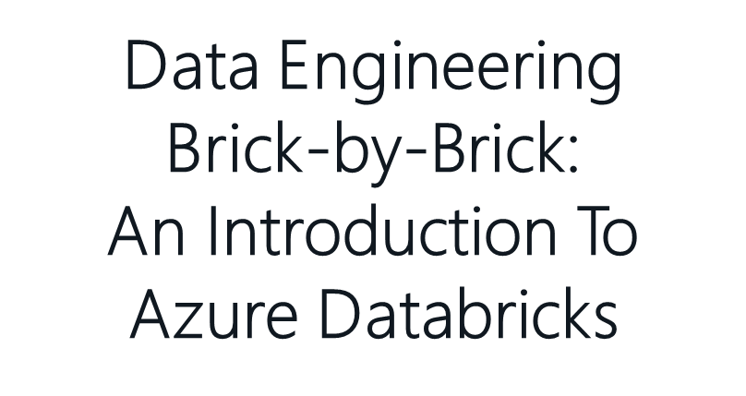


Slide 2

Chris Hyde
He / him pronouns
Microsoft Data Platform MVP
MCSE: Data Management and Analytics
Albuquerque data platform group leader
Contact me:
Twitter: @ChrisHyde325
Email: chrishyde325@gmail.com
Owner and Principal Consultant
Hydrate Consulting, LLC
@ChrisHyde325

Slide 3
agenda
What is Azure Databricks?
What is Data Engineering?
What is a Data Warehouse?
Using Azure Databricks Notebooks
Working with .csv and JSON data
Collaborative analysis environment

Slide 4
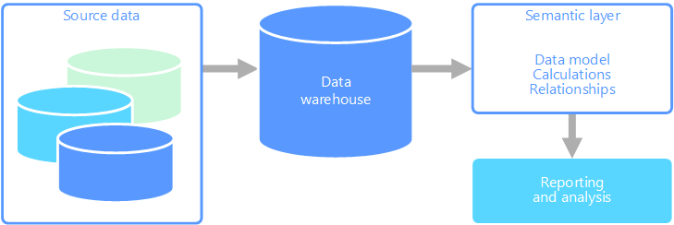
traditional data warehouse architecture

Slide 5
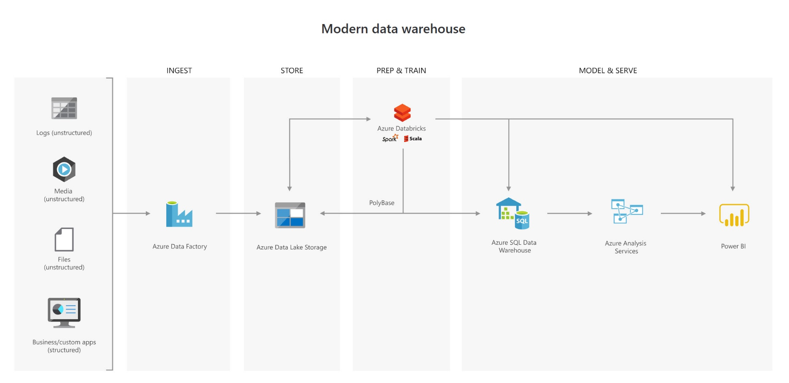
modern data warehouse architecture

Slide 6
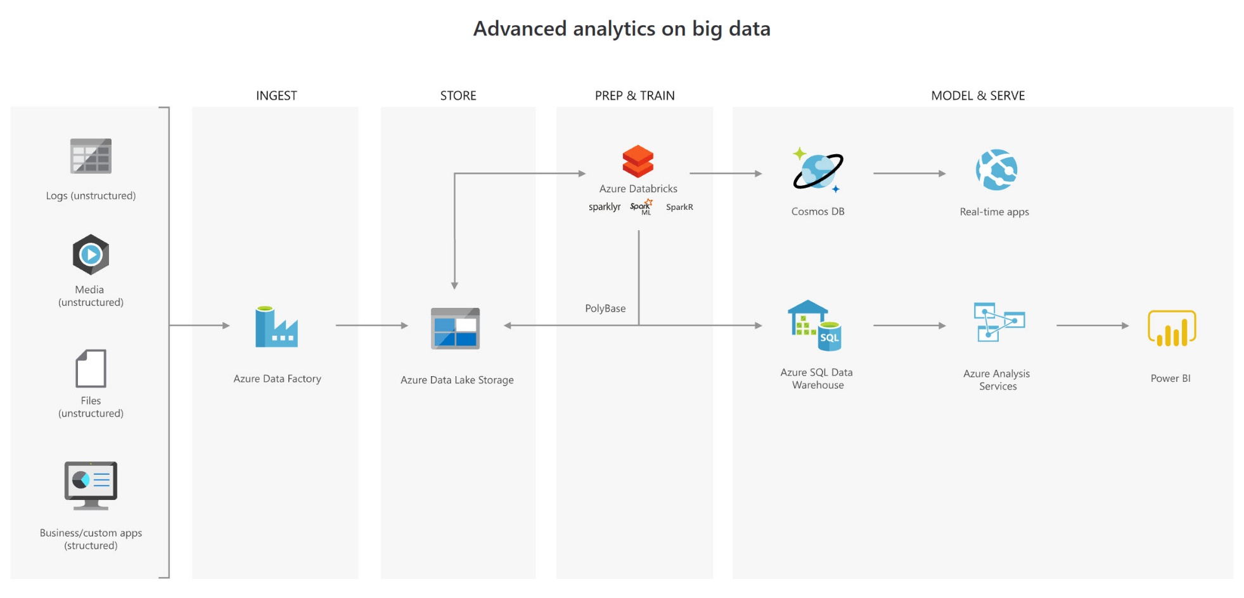
advanced analytics architecture

Slide 7
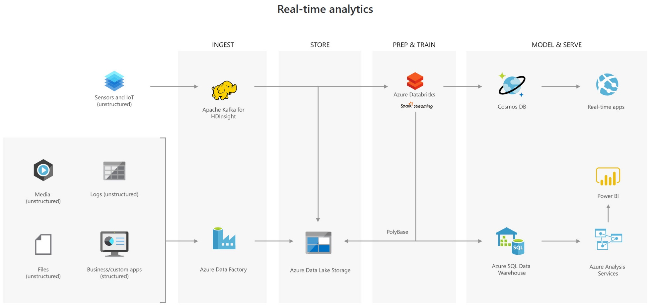
real-time analytics architecture

Slide 8
what is a data engineer?
key role in the modern data warehouse architecture
80% of Data Science
evolution of the traditional DBA

Slide 9
what is Azure Databricks?
Azure version of the cloud-based Databricks product
fully managed implementation of Apache Spark
very large scale distributed data processing
only pay for the Compute that you actually use

Slide 10
real-time analytics architecture

Slide 11
Apache Spark notebooks
read and process large files and other data sets
explore, query, analyze, and visualize data sets
join disparate data sets found in data lakes
process live streams of data
train and evaluate machine learning (ML) models
analyze large graph data sets, i.e. social networks
Python, Scala, R, SQL

Slide 12
Getting started with Azure Databricks
Demo

Slide 13
resources
this presentation
https://github.com/Drjekyll325/SQLServer/tree/master/Presentations
Microsoft Learn tutorials
https://docs.microsoft.com/en-us/learn/paths/data-engineer-azure-databricks/
https://docs.microsoft.com/en-us/learn/paths/perform-data-science-azure-databricks/
video series by Advancing Analytics
https://www.youtube.com/playlist?list=PLHN2ijxAWBaNM3EA0hM6ZxWuOvVAeDzha

Slide 14
Demo notebooks
Importing .csv and .json files
https://github.com/solliancenet/microsoft-learning-paths-databricks-notebooks/blob/master/data-engineering/DBC/03-Reading-and-writing-data-in-Azure-Databricks.dbc?raw=true
Collaborative analysis on graph data
https://databricks-prod-cloudfront.cloud.databricks.com/public/4027ec902e239c93eaaa8714f173bcfc/3741049972324885/3065536941249190/4413065072037724/latest.html

